Slide 1

SECURITY SYSTEMS
Snort and how to use it? How it reports attacks?
IBRAHIM DEVECI - 16030411052

Slide 2
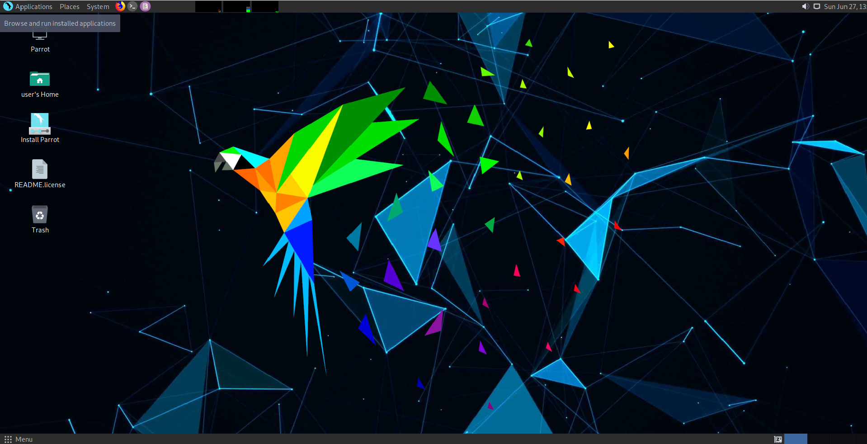
Firstly install Parrot OS into your Virtual Machine

Slide 3
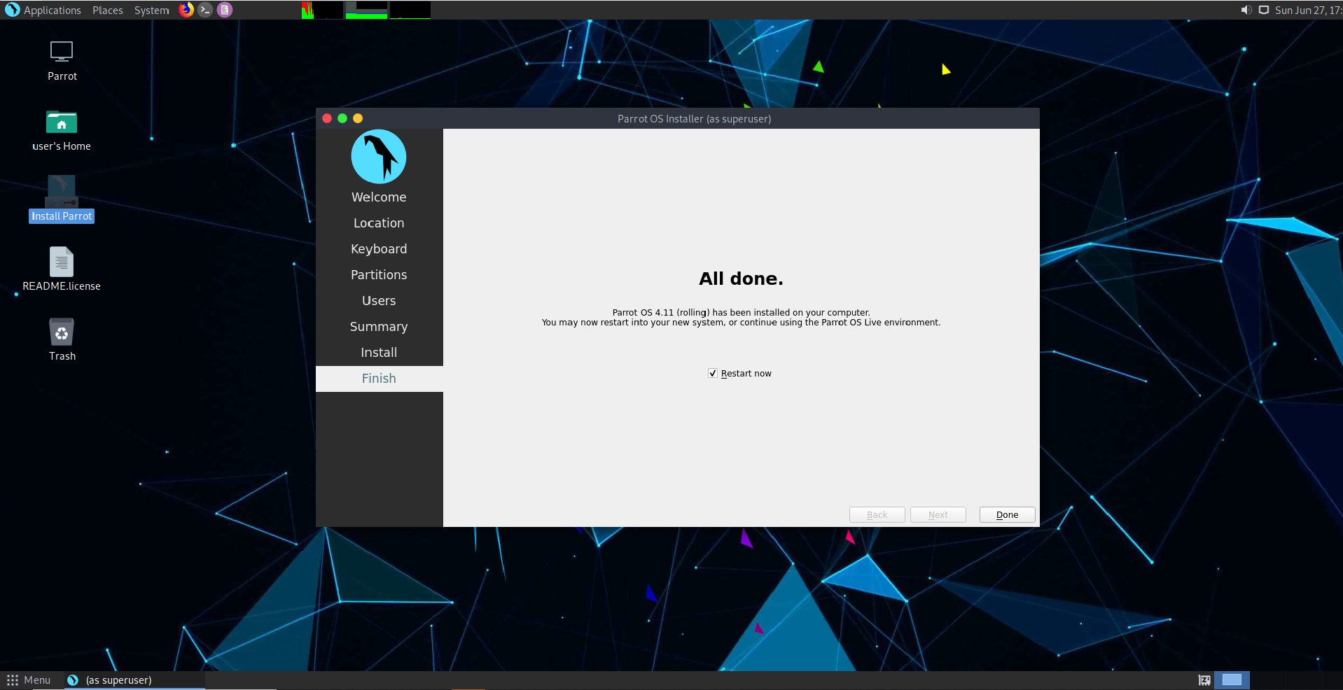
After ıt ıs done wıth ınstallatıon, restart ıt.

Slide 4
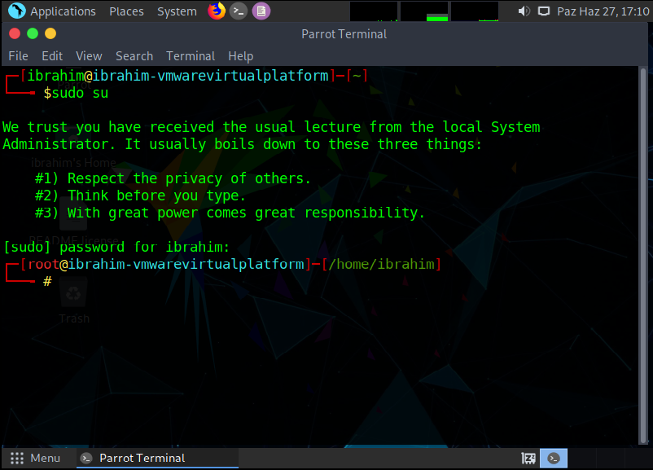
When restart completed we are openıng command lıne and typıng sudo su then ıt asks for password for thıs os and we are typıng ıt

Slide 5
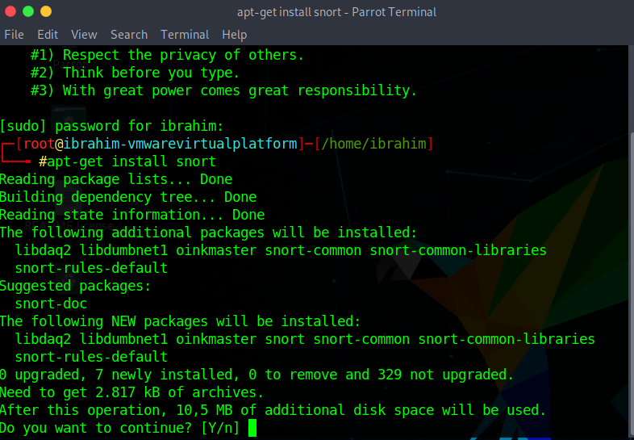
Then we are enterıng apt-get ınstall snort command to ınstall snort to our parrot os

Slide 6
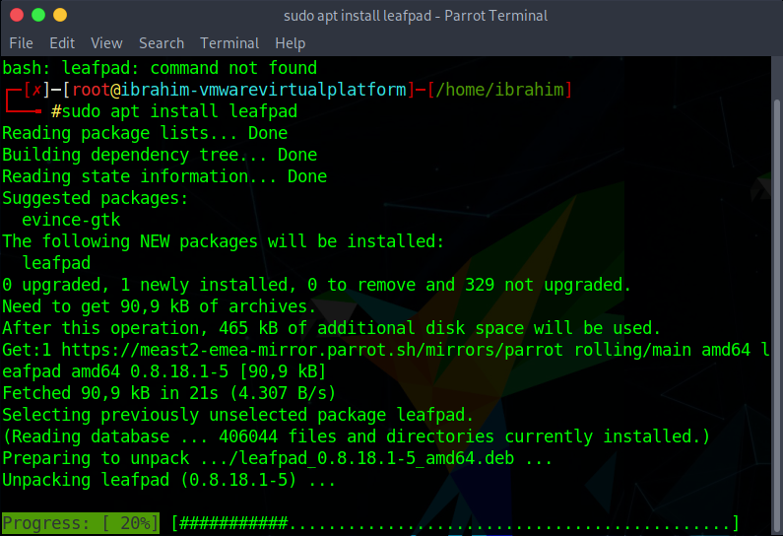
FOR FURTHER STEPS WE ARE INSTALLING LEAFPAD WHICH IS A EQUAL TO NOTEPAD IN WINDOWS OS. For thıs we are enterıng sudo apt ınstall leafpad command.

Slide 7
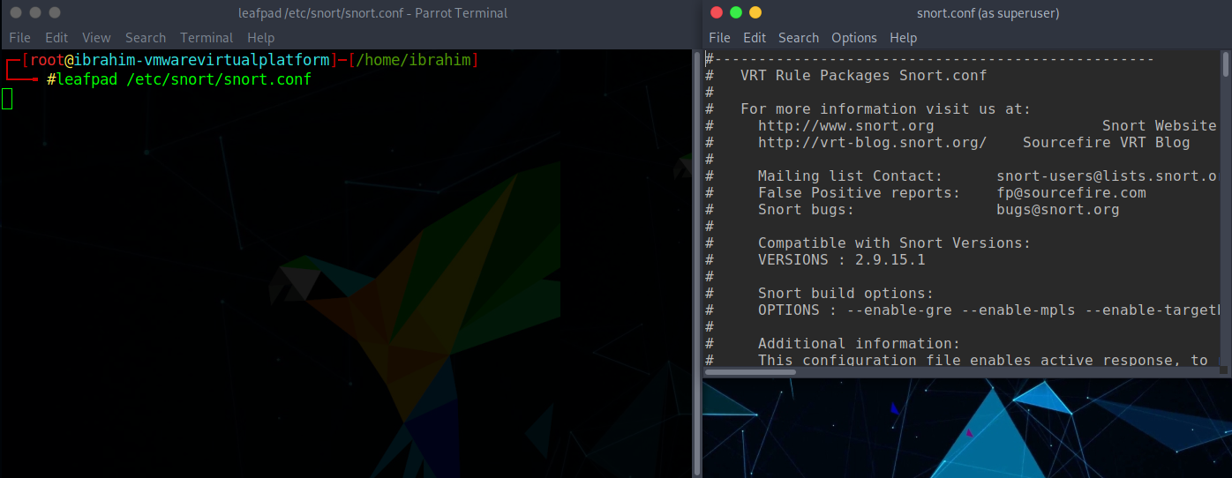
WHEN WE ARE DONE WITH LEAFPAD WE ARE ENTERING THE COMMAND LEAFPAD /ETC/SNORT/SNORT.CONF TO CONFIGURE SNORT.

Slide 8
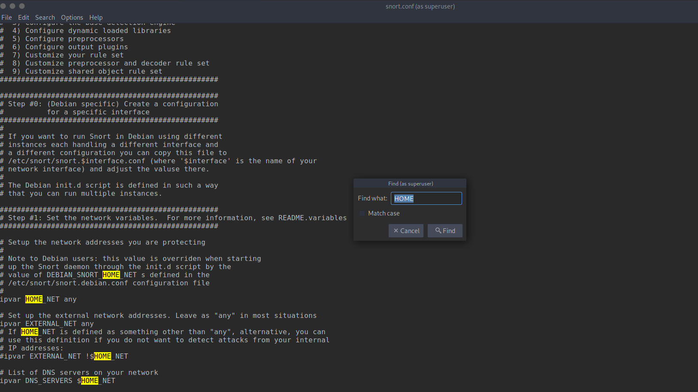
In the confıguratıon lıst we are usıng the ctrl+f command the fınd the related part we want

Slide 9
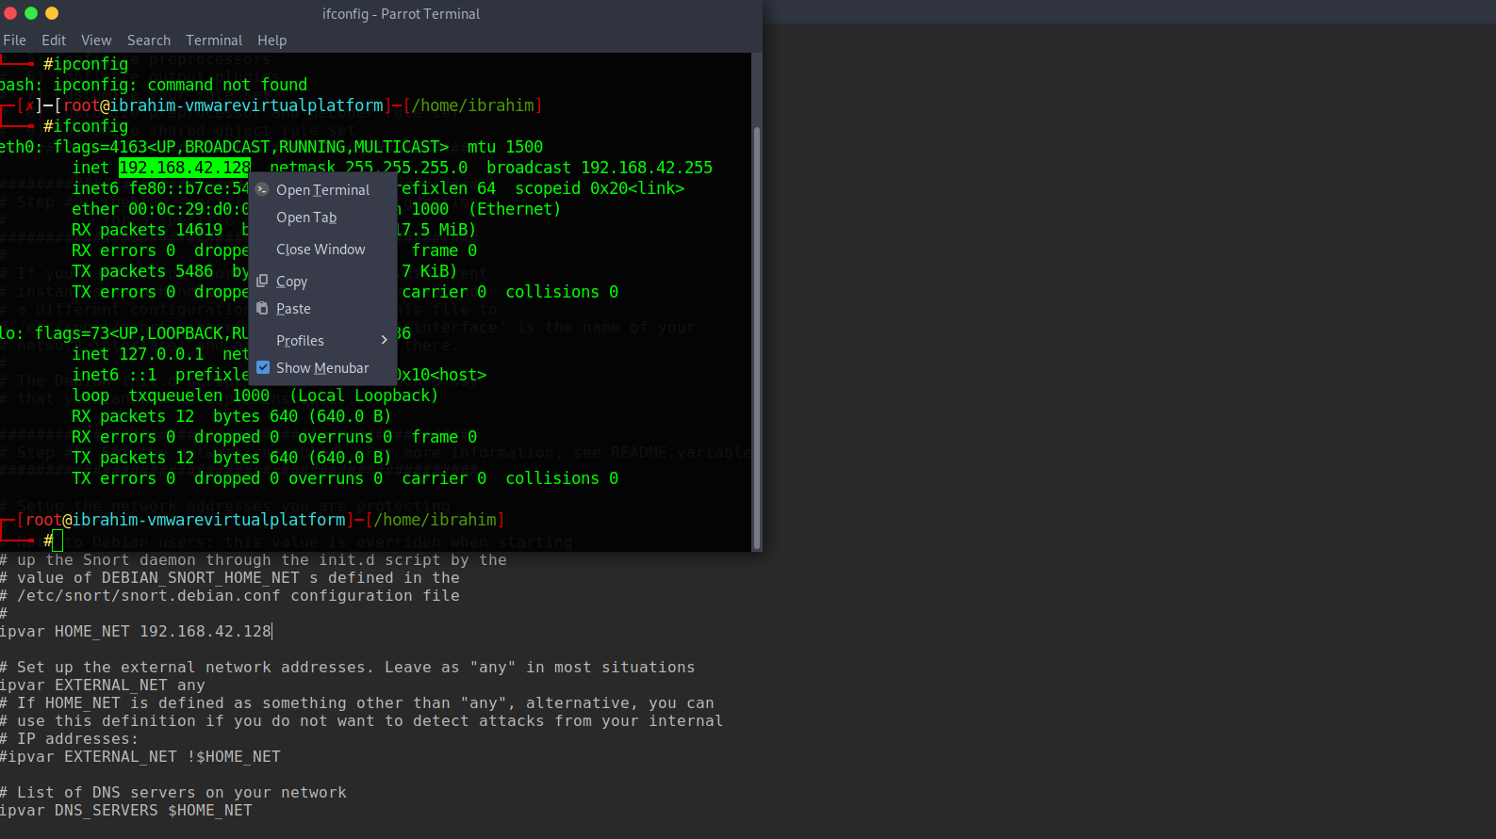
WHEN WE FIND THE IPVAR HOME_NET PART IN THE CONFIGURATION LIST WE ARE OPENING A NEW COMMAND TERMINAL AND TYPING IFCONFIG TO GET OUR IP WHICH IS HIGHLIGHTED IN THE IMAGE. LETS COPY THE IP AND PASTE IT INTO CONFIGURATION.

Slide 10
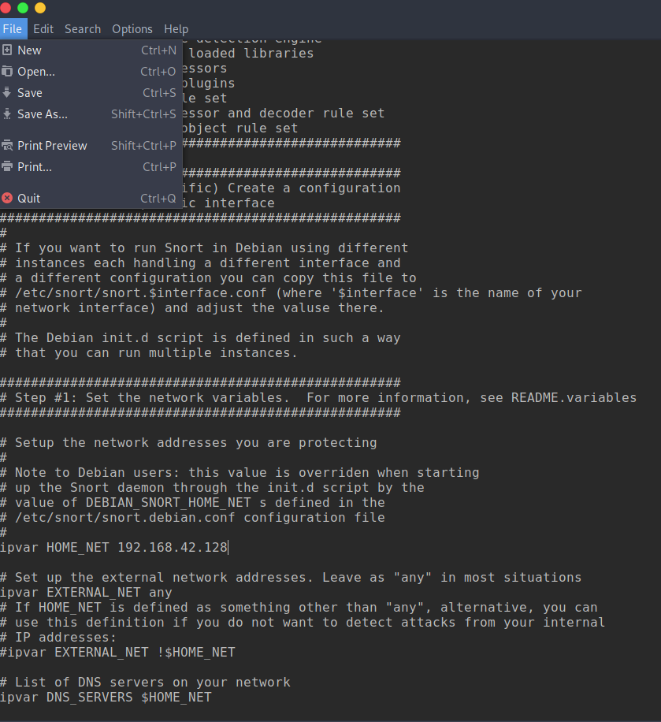
WHEN WE ARE DONE WE ARE SAVING IT AND CLOSING.

Slide 11
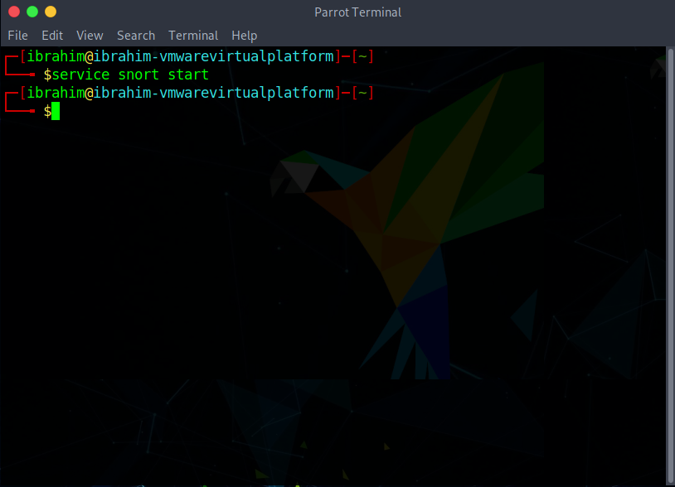
LET’S START THE SNORT APPLICATION WITH COMMAND SHOWN IN IMAGE.

Slide 12
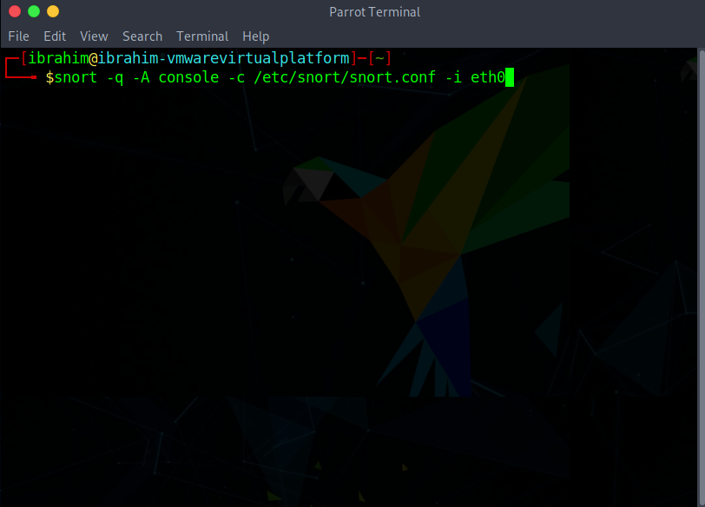
Now snort ıs up and runnıng we are enterıng the command whıch ıs shown ın the ımage. Thıs command wıll adjust the snort to report the ıncomıng attacks for the parameters we have gıven before (the ıp address).

Slide 13
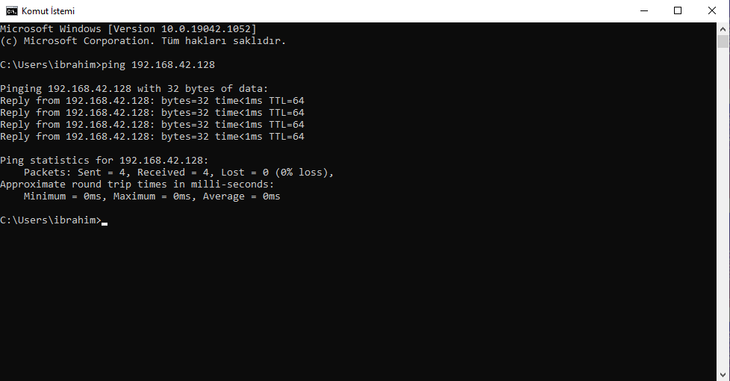
LET’S SIMULATE AN ATTACK WITH PINGING OUR PARROT OS IP ADRESS.

Slide 14
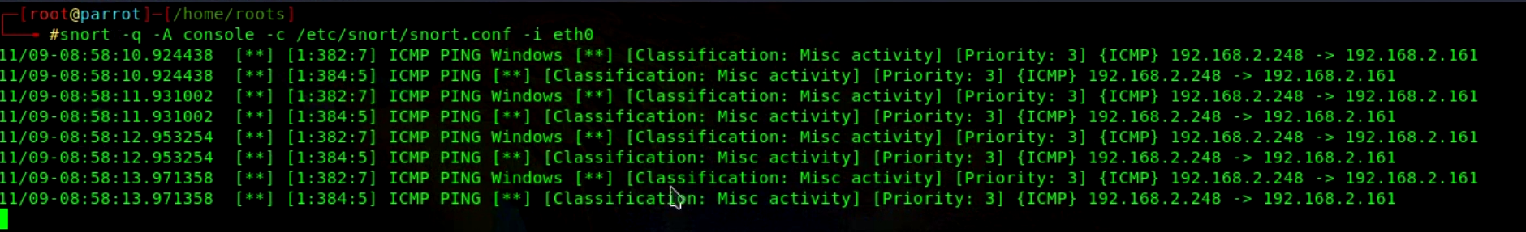
When we pıng our parrot os snort wıll gıve us reports lıke thıs.

Slide 15

THANK YOU!

